Slide 1


Pimpri Chinchwad Education Trust (PCET)
Pimpri Chinchwad College of Engineering
An ISO 9001:2015 Certified Institute, NBA Accredited, Accredited by NAAC with ‘A’ grade
Department of Information Technology
AgriHelp: A Unified AI-Driven Platform for
Precision Agriculture and Sustainable Farming
Presented By
Name of Students (PRN No)
Vaibhav Ambhore 121B1F002
Pragati Gadkar 121B1F029
Esha Govardhan 121B1F033
Guided By
Name of Guide
Dr. Roshani Raut
Notes:
‹#›

Slide 2

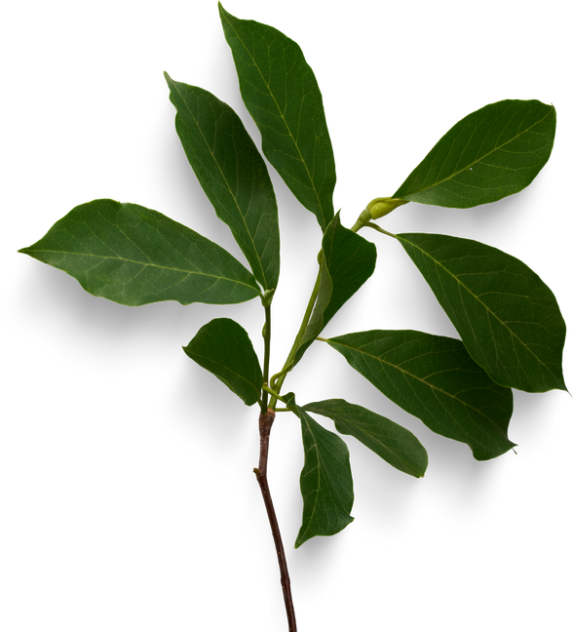


CONTENTS
Introduction
Objectives and Scope of the Project
Literature Survey
Requirements
Methodology
System Architecture
Design UML Diagrams
Implementation Video
Advantages & Applications
Conclusion

Slide 3
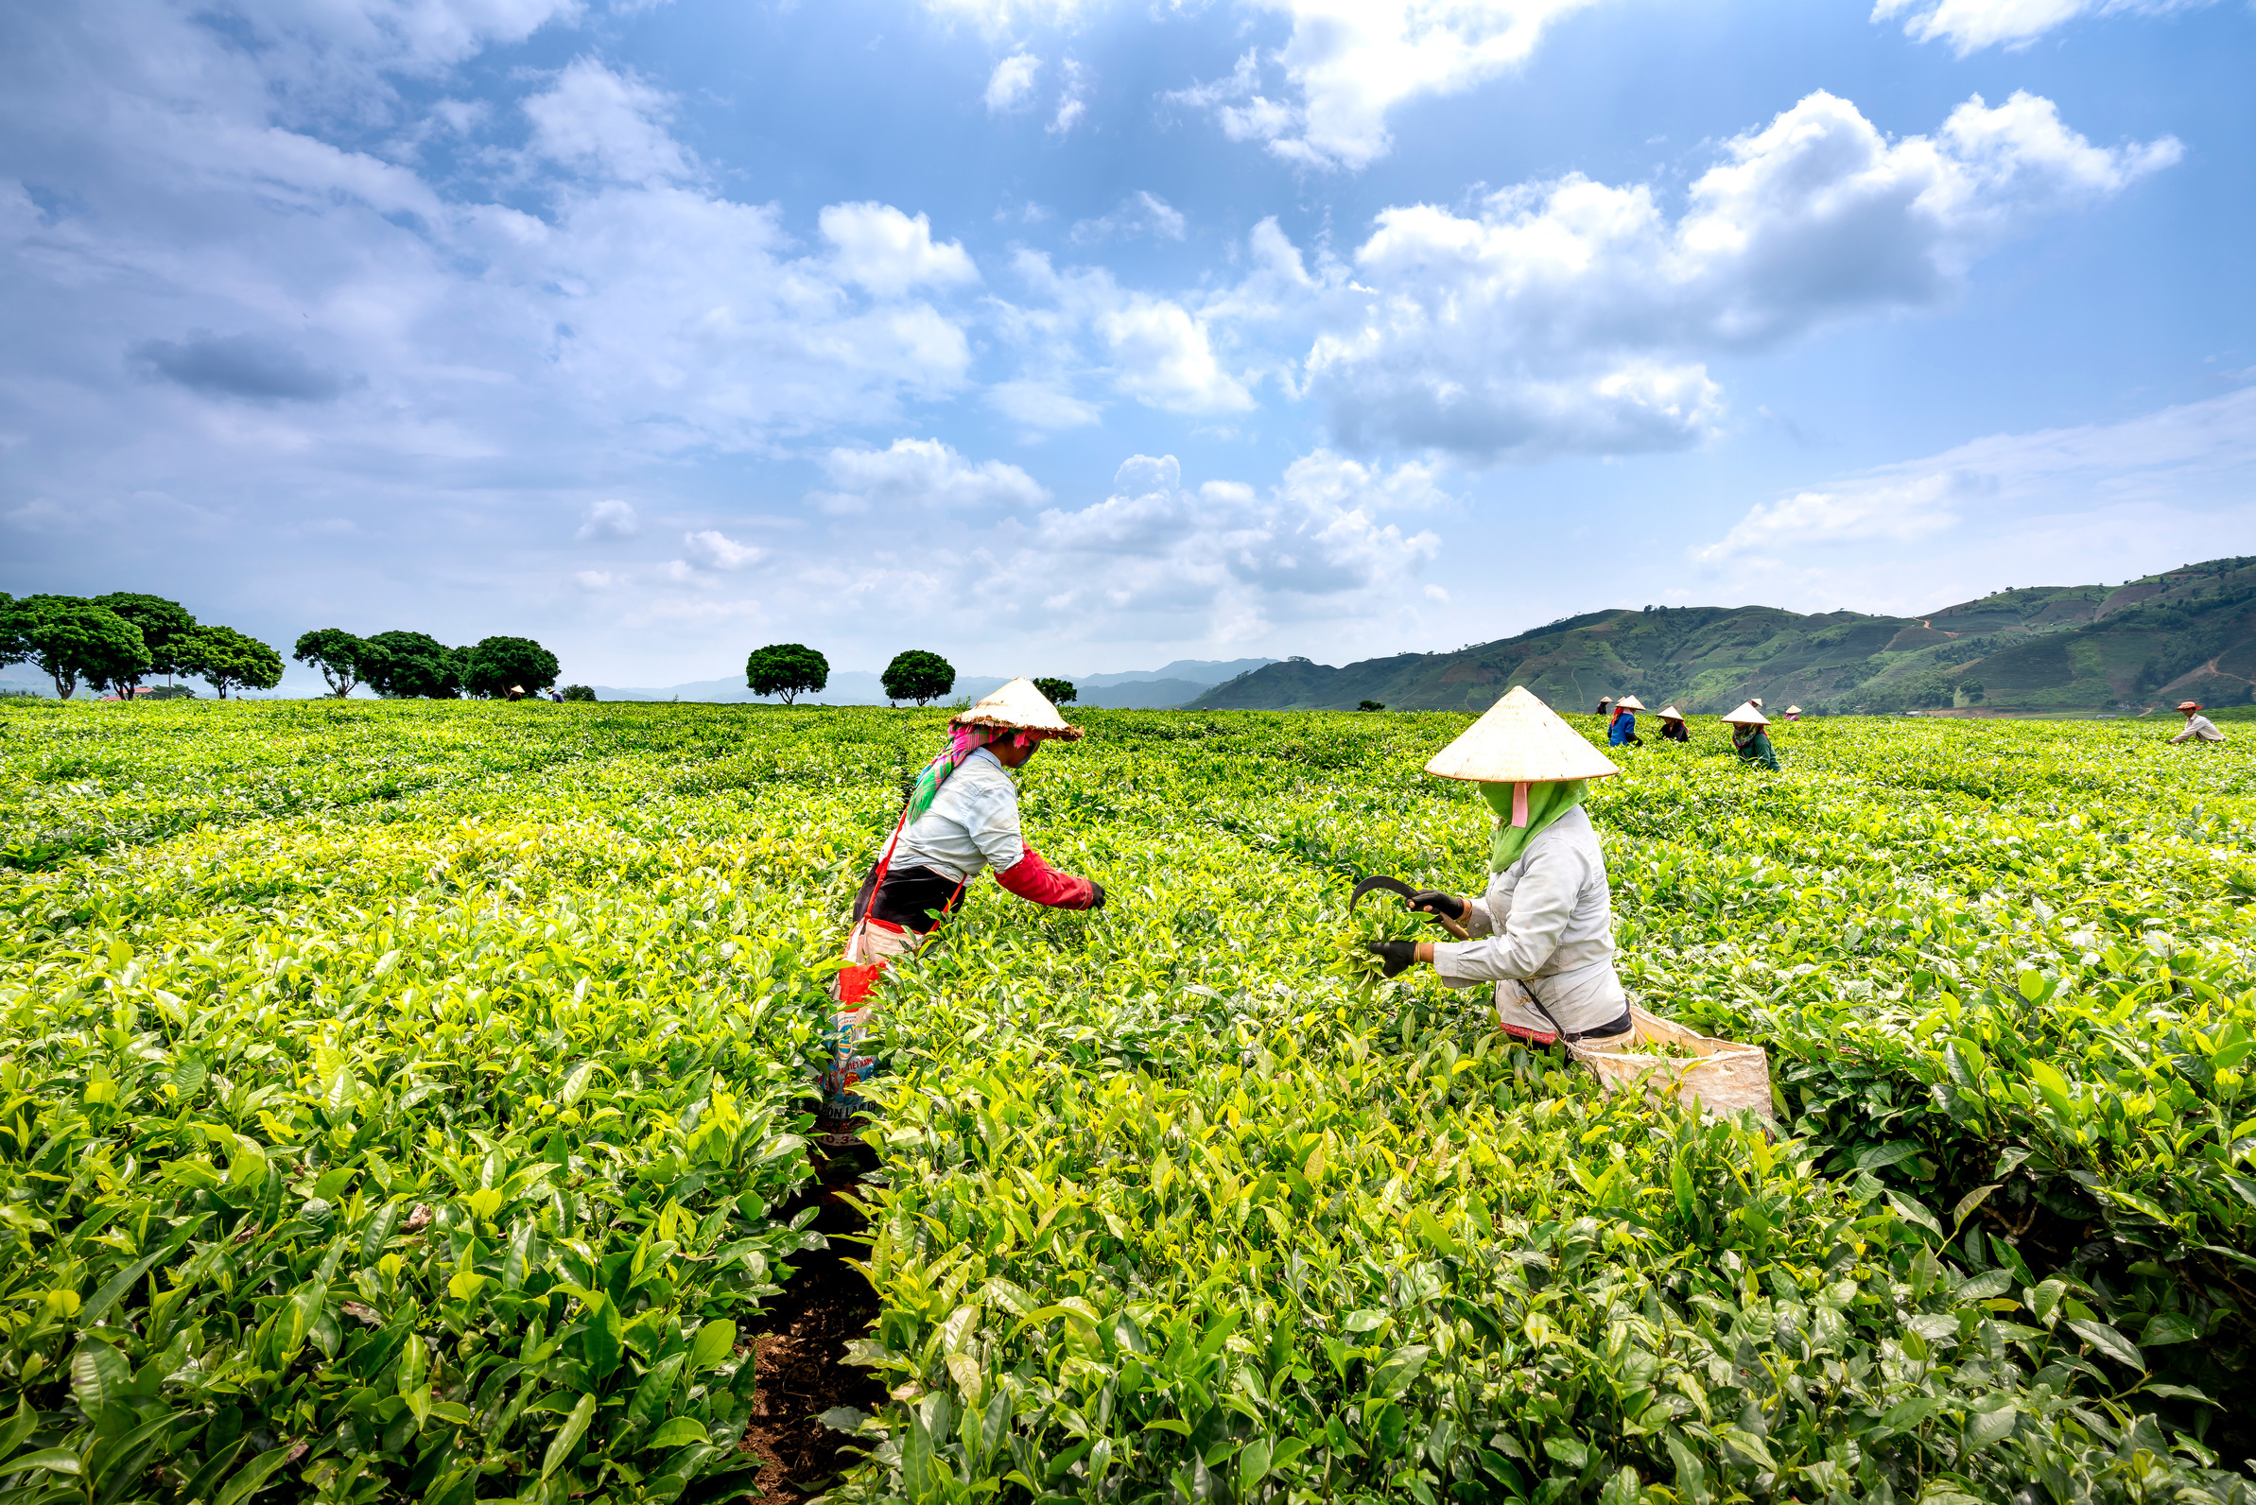



INTRODUCTION
01
Motivation
Problem Statementon
Scope
Traditional Indian farming often relies on experience-based decisions, which may not align with scientific or real-time data insights.
Farmers struggle with pest infestations, plant diseases, and poor soil health, resulting in reduced crop yield and financial losses.
Many AI-based solutions that exist are fragmented, lack regional adaptation, or are too complex for small and marginal farmers to use.
To develop AgriHelp, an AI-powered, web-based platform that consolidates multiple ML models to provide:
Crop recommendation based on soil health and climate.
Fertilizer suggestion tailored to nutrient levels and crop type.
Disease and pest detection using leaf/pest image uploads.
The goal is to enable farmers to make data-driven decisions, optimize resources, and reduce yield loss.
Focused on precision agriculture for Indian regions, especially Maharashtra.
Supports recommendations for 18+ crops and 30 common pest types using regional datasets.
Includes both tabular and image-based ML models for varied user input types.
Scalable architecture enabling future integration with weather APIs, market price feeds, and IoT-based sensors.

Slide 4
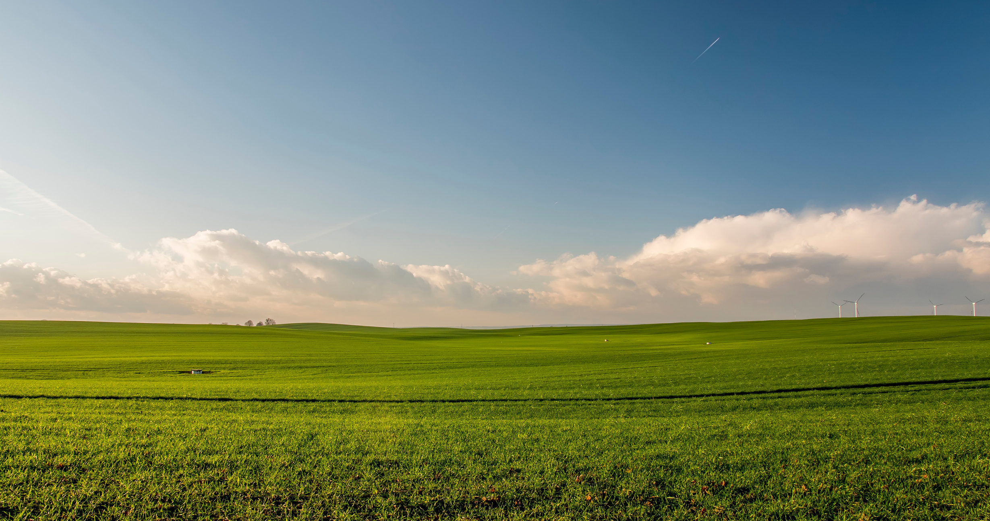

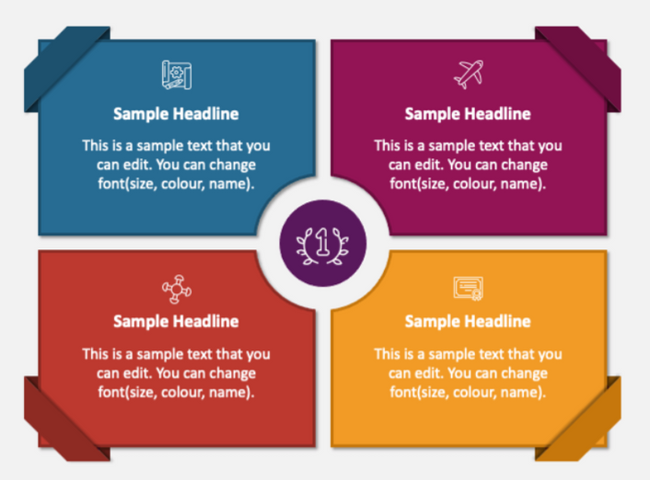
OBJECTIVES & SCOPE
02
Objectives
Scope
Create a crop recommendation model based on soil and weather data
Develop fertilizer recommendation model tailored to specific crops and
conditions.
Streamline the decision-making process by providing actionable insights and recommendations, minimizing the time and effort required for farmers to access crucial agricultural data.
Build a disease prediction model using image recognition techniques.
Design an insect identification model to assess pest threats.
Ensure that the system meets user needs by offering reliable, accurate information and responsive support, leading to increased confidence in their farming decisions.

Slide 5

LITERATURE SURVEY
03
Paper Title | Publication Year | Journal / Conference | Key Findings/Reviews
Crop Disease Detection Using YOLO | 2020 | 2020 International Conference for Emerging Technology (INCET) | Implemented different YOLO versions for crop disease detection.
Era of quantum computing- An intelligent and evaluation based on quantum computers | 2019 | International Journal of Recent Technology and Engineering (IJRTE), Vol. 8 | Discussed the era of quantum computing and its potential applications and evaluations.
Plant Diseases and Pests Detection using Machine Learning | 2023 | 2023 3rd Asian Conference on Innovation in Technology (ASIANCON) | The proposed method shows in detecting leaf diseases in plants, which is crucial for promoting healthy plant growth and ensuring ample food supply
Recognition of ginger leaf pests and diseases in natural scenarios based on improved YOLOv5s | 2024 | Transactions of the Chinese Society of Agricultural Engineering, 40 (01) | Studied the recognition of ginger leaf pests and diseases in natural settings using an improved YOLOv5s.

Slide 6
LITERATURE SURVEY
04
Paper Title | Publication Year | Journal / Conference | Key Findings/Reviews
Technological Advancements in Automated Crop Pest and Disease Detection: A Review & Ongoing Research | 2022 | International Conference on Computing, Communication, Security and Intelligent Systems (IC3SIS) | This documents demonstrates the comprehensive review of research efforts done in agricultural domain using image processing techniques.
Leaf Diseases Prediction Pest Detection and Pesticides Recommendation using Deep Learning Techniques | 2023 | International Conference on Sustainable Computing and Data Communication Systems (ICSCDS-2023) | The study demonstrates that a transfer learning-based ResNet-50 model, can accurately diagnose plant diseases, recommend pesticides.
Improved crop leaf pest recognition algorithm based on YOLOv8 | 2024 | Chinese Journal of Agricultural Mechanization, 45 (07): 255-260 | Presented an improved algorithm based on YOLOv8 for recognising crop leaf pests.
Supervised Deep Learning based Leaf Disease and Pest Detection using Image Processing | 2023 | 7th International Conference on Intelligent Computing and Control Systems (ICICCS-2023) | The VGG16 and YOLOV5s models are deployed with ADAM optimizer.

Slide 7


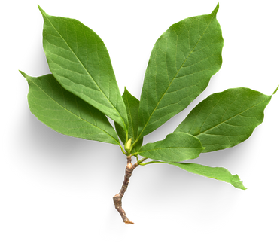
REQUIREMENTS
05
Functional Requirements
Non-Functional Requirements
User Authentication
Profile: Personal & farm info
Performance: Fast response time
Security: JWT auth, encrypted uploads
Crop & Fertilizer Prediction
(Input data → ML model output)
Usability: Mobile-friendly, regional language
Disease & Pest Detection
(Upload image → Prediction)
Scalability: Cloud-based, multi-user
History
(Save & view past results)

Slide 8








TECH STACKS
06
Frontend
Cloud/Storage
Database
Notifications
Backend
Algorithm and pretrain Models
(SMS)
Random Forest
ResNet50
MobileNetV2
(Emails)

Slide 9

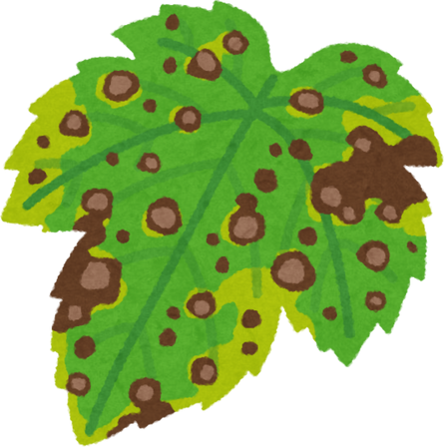
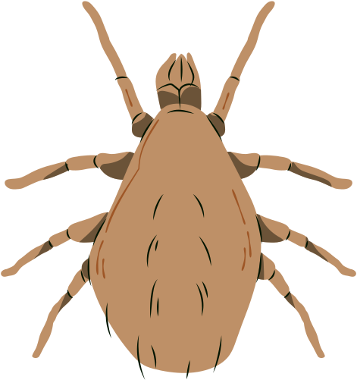
METHODOLOGY
07
Crop & Fertilizer Dataset
Plant Leaf Disease Dataset
Pest Detection Dataset
Source: Open-source data portals like kaggle.
Original Data: 5073 records specific to Maharashtra
Attributes: Nitrogen, Phosphorus, Potassium, pH, Rainfall, Temperature, Humidity, Crop Name, Fertilizer.
Modified Dataset:
Removed missing/irrelevant entries.
Normalized numerical features (e.g., NPK, pH).
Label encoding, split into training (80%) and testing (20%) datasets.
Source: Public datasets including Kaggle, and academic repositories.
Original Data: Different Datasets according to plants.
Modified Dataset:
56 classes of various crops
Various diseased leaf images for various crops (e.g., Apple, Cotton, Tomato, Rice)
Resized images to 256x256 px for performance.
Applied image preprocessing (normalization, noise removal).
Split: 80% train, 10% validation, 10% test.
Source: IP102 Dataset – A large-scale benchmark pest dataset.
Original Data:
75k images.
102 pest species including aphids, beetles, caterpillars, whiteflies, etc.
Modified Dataset:
Selected 15 most relevant pests for Indian crops.
Resized images to 256x256 px for performance.
Balanced dataset using image augmentation (rotation, zoom, flip).
Split: 80% train, 10% validation, 10% test.

Slide 10
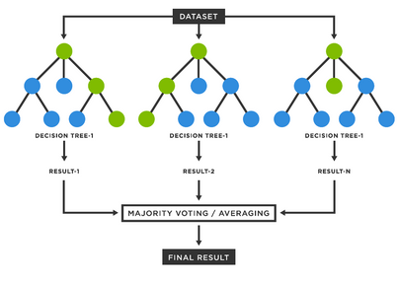
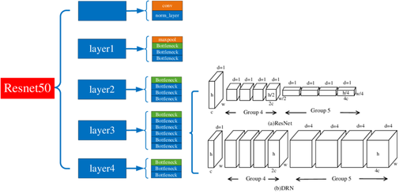
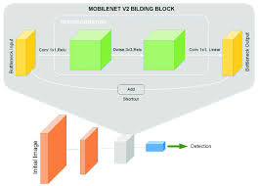
ALGORITHMS USED
08
ResNet50
Type: Deep Convolutional Neural Network (50 layers)
How it Works:
Uses residual connections (skip connections) to prevent vanishing gradient problems in deep networks.
Pretrained on ImageNet; fine-tuned for plant diseases.
Advantages:
High accuracy even with limited agricultural image data.
Learns complex disease patterns from leaf textures and colors.
Random Forest
Type: Ensemble ML Algorithm
How it Works:
Builds multiple decision trees on random subsets of the data.
Final prediction is made by majority voting (classification).
Advantages:
Handles categorical & numerical data.
Reduces overfitting by averaging across trees.
Ranks feature importance (e.g., N, P, K, pH).
MobileNetV2
Type: Lightweight Convolutional Neural Network
How it Works:
Uses depthwise separable convolutions to reduce model size and computation.
Designed for mobile/web deployment with fast inference.
Advantages:
Efficient and fast.
Performs well even on resource-constrained devices like mobile phones or web apps.

Slide 11
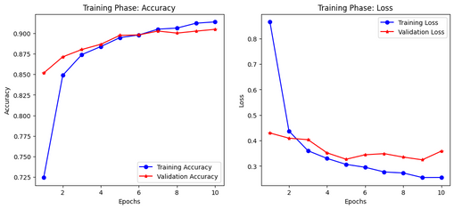
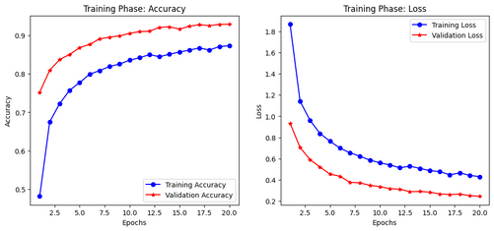
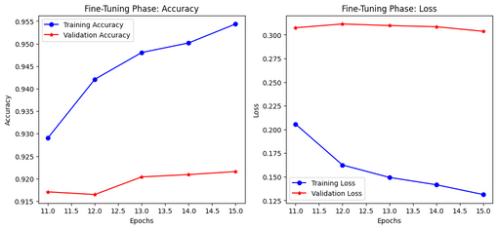
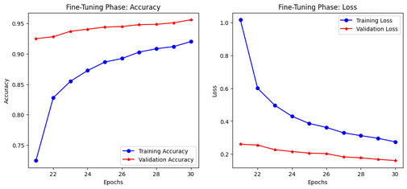
METHODOLOGY
09
Model | Learning Rate | Epochs | Batch Size | Optimizer | Loss Function
ResNet50 | 1e-3 → 1e-5 | 50 | 32 | Adam | Categorical CrossEntropy
MobileNetV2 | 1e-3 → 1e-5 | 50 | 32 | Adam | Categorical CrossEntropy
Hyperparameter Tuning
Fine Tuning Phase of MobileNetV2
Fine Tuning Phase of ResNet50
Training Phase of MobileNetV2
Training Phase of ResNet50

Slide 12
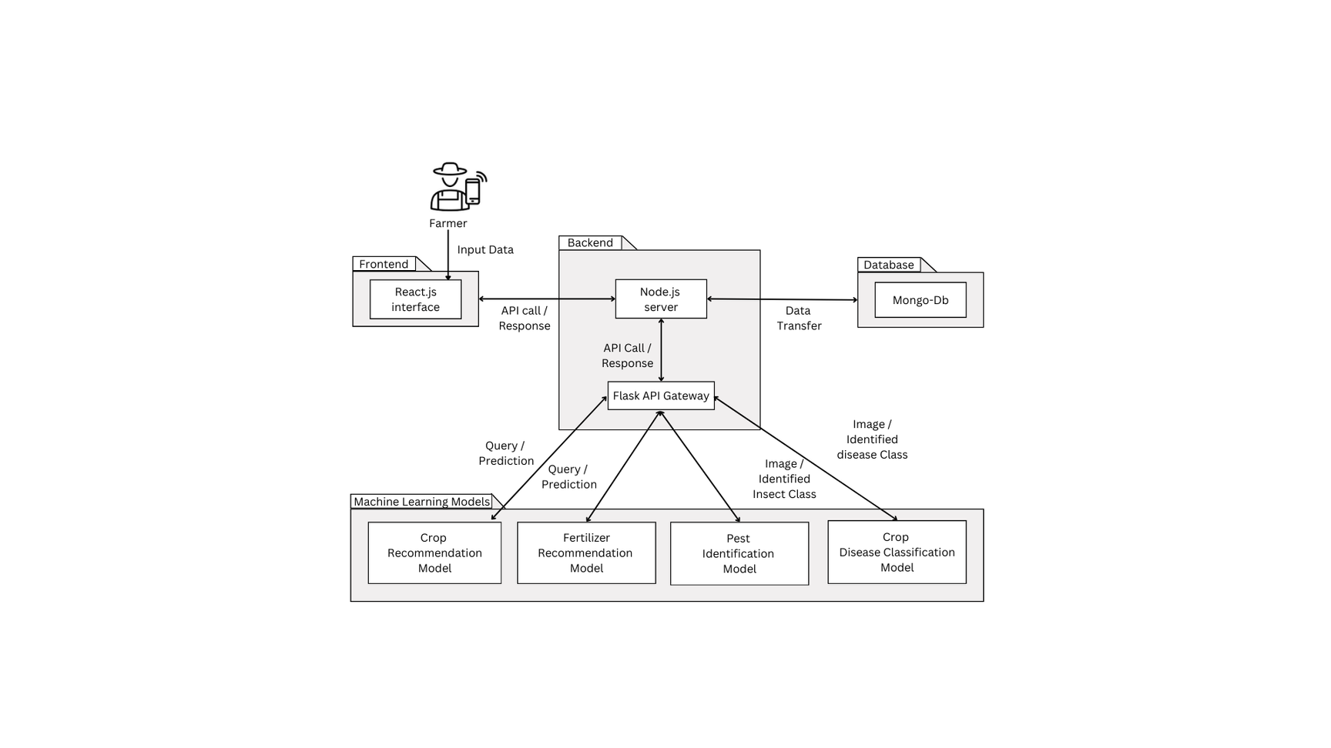
SYSTEM ARCHITECTURE
10

Slide 13
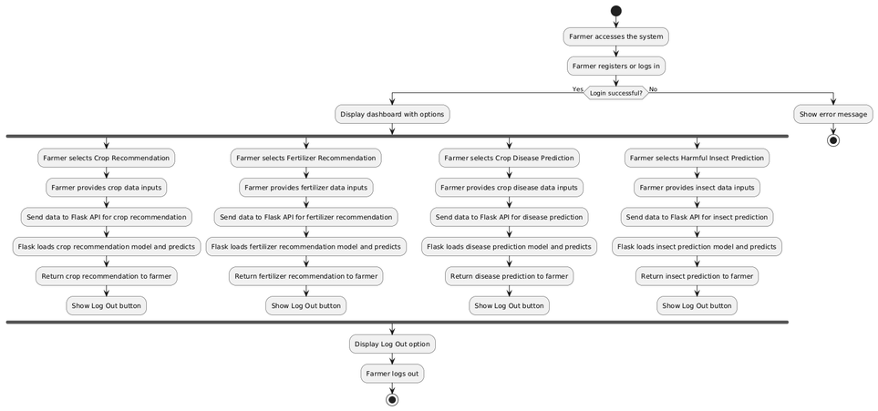
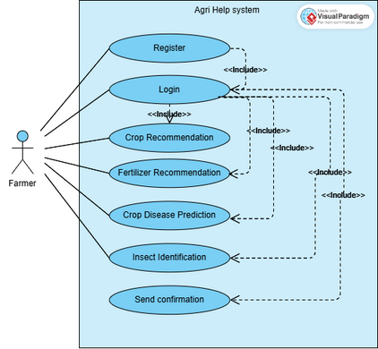
DESIGN : UML DIAGRAMS
11
Use Case Diagram
Activity Diagram

Slide 14
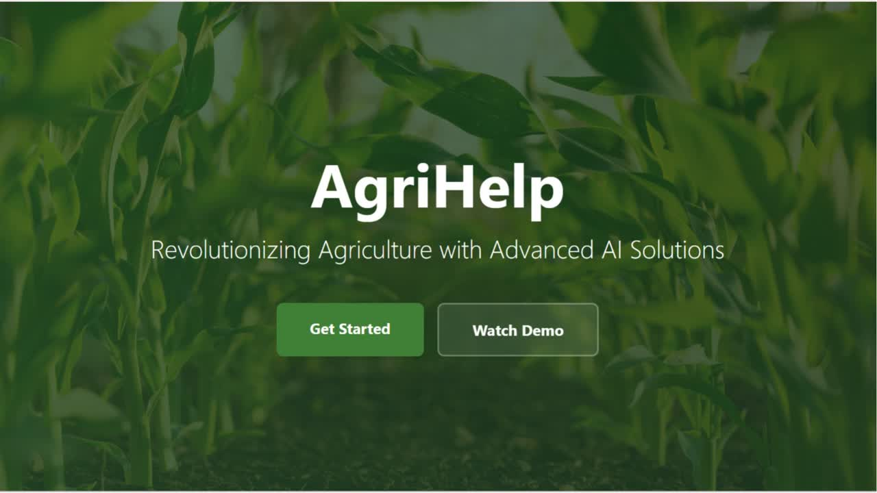
IMPLEMENTATION VIDEO
12

Slide 15
Advantages & Applications
13
Applications
Crop Management: Assists in selecting suitable crops based on local conditions.
Fertilizer Optimization: Offers specific recommendations for nutrient delivery.
Disease Prediction: Allows real-time diagnoses through image uploads.
Pest Control: Identifies harmful pests and suggests control measures.
Agricultural Research: Analyzes data trends to improve practices.
Extension Services: Aids extension officers in providing personalized advice to farmers.
Advantages
Improved Decision-Making: Provides data-driven insights for informed farming choices.
Increased Productivity: Optimizes practices to enhance crop yields.
Resource Efficiency: Minimizes waste of water and fertilizers.
Early Detection: Enables timely intervention for diseases and pests.
User-Friendly Interface: Accessible for farmers with varying technical expertise.
‹#›

Slide 16
CONCLUSION
14
Model Effectiveness
Impact on Agriculture
Future Enhancements
Random Forest achieved 99.6% and 99.94% accuracy for crop and fertilizer recommendation respectively.
ResNet50 provided 94.53% accuracy in disease classification.
MobileNetV2 yielded 96.03% accuracy for pest detection.
All models were trained and validated on region-specific, well-preprocessed datasets, ensuring high reliability.
Encourages data-driven farming by replacing guesswork with actionable insights.
Minimizes resource wastage by recommending precise input usage.
Supports early detection of diseases/pests, reducing crop loss.
Contributes to sustainable and smart agriculture aligned with UN SDGs.
Weather integration using real-time APIs for even more accurate recommendations.
Local language support for regional accessibility.
Mobile App version for offline / remote usage.
Inclusion of livestock monitoring and market price forecasting.
Integration with government schemes/APIs for subsidy & advisory support.

Slide 17


